Slide 1
Technical Experts Roundtable
Calvin Cornish Jr., Johnson Controls Inc.
Art Burton, AMB Renewable Energy
Dan Curley, Ameresco
Jenny Maltas, Veregy
Tomás de'Medici, Reactivate
Aditi Desai, Voltpost

Slide 2
Reducing The Worlds Carbon Foot Print One Step At A Time

Slide 3
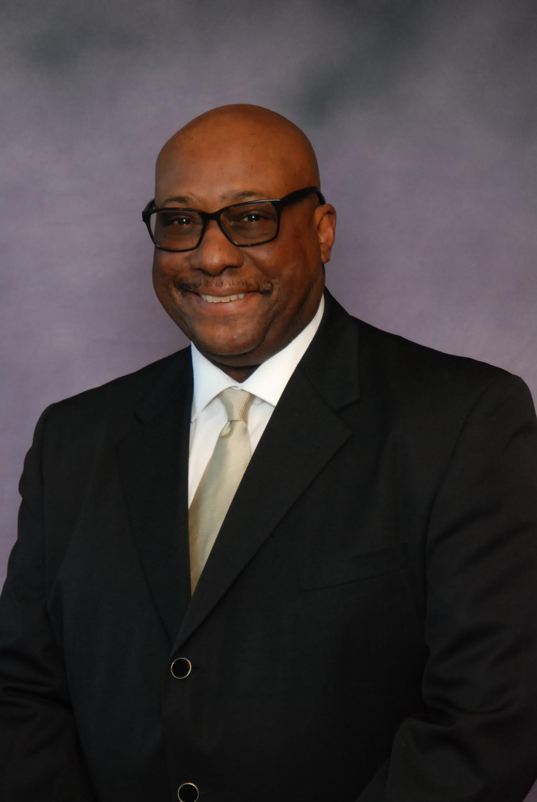
Arthur M. Burton Project Management Agent for AMB Renewable Energy Efficiency Products and Services
Established AMB Renewable Energy Inc. 2019 MBE Certified Vendor
We Provide Energy Efficiency Products, Service And Installation For Electrical Vehicle Charging Stations.
We Provide Solar Panels, LED Lighting And Electrical Power Backup Systems For New Development And Retrofits For Both Residential And Commercial Business.
Established Cornell Capital Partners LLC 2011 MBE/Section3 Certified Vendor
Managing Agent For Residential And Commercial Rehab Projects Along With Community And Government Base Developments.
We Support Low-Income Families And Community Outreach Groups Looking To Implement FEJA & CEJA Workforce Development Programs In Underserved Areas.

Slide 4
Qualifications
Completed Bachelor of Science Degree in Telecommunication Management. (DeVry University)
Received Certificate of Completion for NCCER Solar PV Sales and Installation Program. (CUL)
Received Certificate of Completion for Building Electrification Technology Roadmap. (BETR)
Completed Electrical Vehicle Infrastructure Training Program. (EVITP)
Completed Clark Construction Strategic Partnership Program.

Slide 5
Qualifications
Over 18 Years Of Experience with AT&T as a National Project Manager.
Certified Youth Training Mentor 100BMC of America.
EEC-Equity Eligible Contractor.
ICC- Illinois Chamber of Commerce Approved Vendor.

Slide 6
Construction Projects
CHA Rehab-Painting- Concrete-Flooring and Roofing Project.
St. Paul CME Church Chicago Demo-Restoration Project
Thorn Creek Senior Home New Development Project
Safeguard Property Management and Restoration Project
Maywood Soldiers Home Demo-Restoration Project
Prudential Realty New Development and Restoration

Slide 7
CLEAN ENERGY Projects
St. John Episcopal Church – Installation of Level 2 Electrical Vehicle Charging Station.
Plant Chicago Aquaponic Growth-Installation of (2) Level 2 Electrical Vehicle Charging Stations.
St. Paul & the Redeemer Episcopal Church Installation of (1) Level 2 Electrical Vehicle Charging Stations.
Plant Chicago Aquaponic Growth-Installation in Progress (PV) Solar Panel Installation.
Hillcrest Baptist Church Installation in Progress (2) Level 2 Electrical Vehicle Charging Stations and PV Solar Panel Installation.
Chicago Urban League Installation of (2) Level 2 Electrical Vehicle Charging Stations.

Slide 8
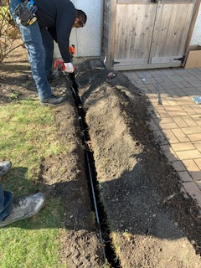
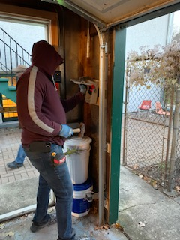
We support Low-income families and Community Outreach Group looking to implement (CEJA) Clean Energy Jobs Act and (FEJA) Future Energy Jobs Acts) Workforce Development programs in underserved areas.
Vision:
Create a career opportunity for underserved
community and provide thriving business
with quality labor and service while improving
the workforce marketplace.
Mission:
Our goal is to engage with all youth ages 14 to
24 with a strong emphasis on drop-outs, and
other high risk youth populations.

Slide 9
Training Program Objectives:
Offer Hands on Training in Real Work Environment Locations
Gain Certified Apprentice Hours for Electrical Contractor License
Acquire OSHA Certification for Fieldwork installation
Collaborate with Minority Contractors on Renewable Energy Projects
Promote ComEd Renewable Energy Resource Products and Incentives
Recognized as ICC Approved Vendor for Renewable Energy Products and Service Installations

Slide 10
Renewable Energy Training Plan:
Electrical Installation Program
Solar Installation Program
Electrical Vehicle Charging Station Installation program
Electrical Heat Pump Installation program
Electrical HVAC System Installation program

Slide 11
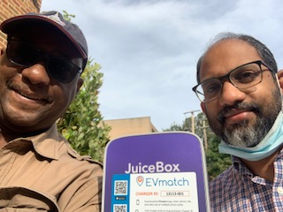
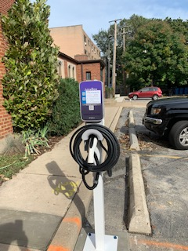
Articles of Recognition
The Washington Post & Hyde Park Harold – St. Paul and the Redeemer.

Slide 12
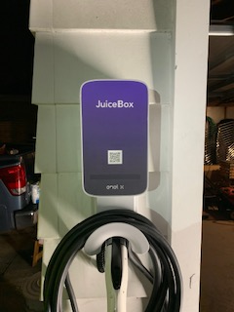
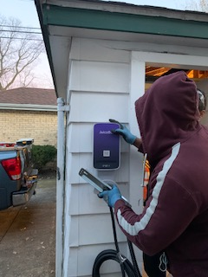
Articles of Recognition
Chicago Area Clean Cities Coalition - St John’s Episcopal Church.

Slide 13
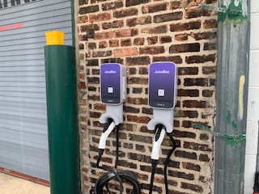
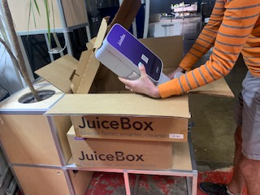
Articles of Recognition
Chicago Area Clean Cities Coalition - Plant Chicago

Slide 14
Diverse EESP Incubator Cohort Program
AMB Renewable Energy is excited to be part of the ComEd 2022 incubator program.
AMB Renewable Energy is looking to bundle ComEd energy savings products with our existing sustainable energy services.
Also Excited to partner with ComEd mentors to take advantage of potential clean energy projects utilizing our Workforce Development Training Program
We feel that the incubator program will help grow our business and expand our clean energy network.

Slide 15
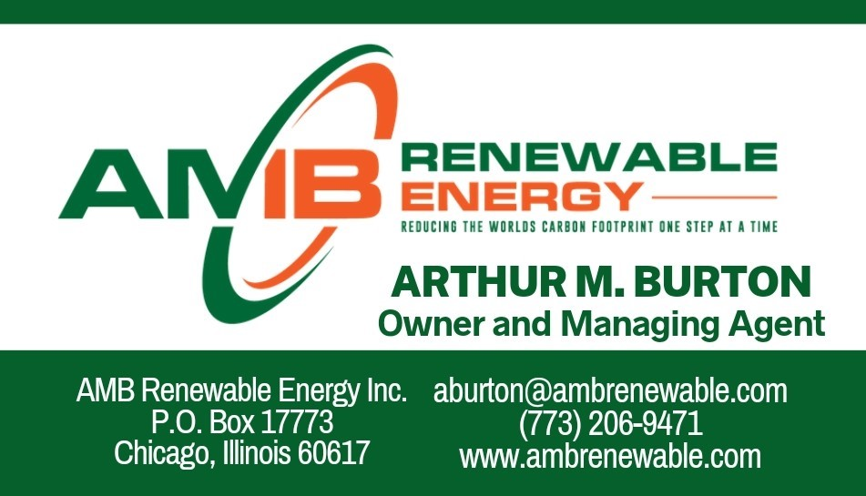
Thank You For The Opportunity To Present
Questions ???

Slide 16
Technical Experts Roundtable
Calvin Cornish Jr., Johnson Controls Inc.
Art Burton, AMB Renewable Energy
Dan Curley, Ameresco
Danielle Melone, Veregy
Tomás de'Medici, Reactivate
Aditi Desai, Voltpost

